Slide 1
Factors Contributing to Hospital Readmission Rates for Diabetes
Minivia Fernandes
Notes:
Intro- defining the problem
Prepare- metrics to measure for, hypothesis
Process- cleaning the data
Analyze- explore trends within the data
Conclusion
Hello! I’ll be presenting a project I was assigned in my health information literacy for data analytics class at UC Davis on factors contributing to hospital readmission rates for diabetes.
Throughout this presentation I will define a problem, explain metrics I’m measuring for, explain how I processed the data, and explore trends in the data.

Slide 2
The Problem
Diabetes is the 7th leading cause of death and affects about 37.3 million people in the U.S.
Cost for hospital readmissions <30 days is ~$25 billion per year in the U.S.
<30 day readmission rates for diabetes are reported to be between 14.4% and 22.7%, much higher than the rate for all hospitalized patients (8.5%–13.5%)
The Opportunity
Early identification of patients facing a high risk of readmission can allow healthcare providers to conduct additional investigations and possibly prevent future readmissions.
Notes:
Diabetes is the 7th leading cause of death and affects about 37.3 million people in the U.S.. in fact, 1.4 million Americans are diagnosed with diabetes every year. In 2017, the hospitalization cost of patients with diabetes in the US was $123 billion. Based on a 20% readmission rate, it is estimated that ~$25 billion would be attributed to 30-day readmission.8 9 furthermore, 30-day readmission rates for diabetes are much higher than the rates for all hospitalized patients. Patients with diabetes represent one-fifth of the overall 30-day hospital readmissions, which is a burden for both clinics and patients. Especially when some of these visits may be preventable through better continuity of care.
Readmission can indicate that inadequate care was provided to the patient at the time of first admission. So readmission rate has become an important metric measuring the overall quality of a hospital.
If a patient is readmitted within 30 days of being released from care, Medicare can also issue financial penalties, so stakeholders who’d be interested in this project would be the hospital officials who can use the results to figure out which patients have higher chance of readmission.
So here, the opportunity is that Early identification of patients facing a high risk of readmission can allow healthcare providers to conduct additional investigations and possibly prevent future readmissions.
https://www.ncbi.nlm.nih.gov/pmc/articles/PMC7418689/

Slide 3
Hypothesis
Patients with higher age, history of a higher number of emergency visits, higher number of diagnoses, no medication prescription, and a change in medication are more likely to get readmitted within 30 days.
Notes:
Patients with higher age, history of a higher number of emergency visits, higher number of diagnoses, no medication prescription, and a change in medication are more likely to get readmitted within 30 days.
My aim was to identify patterns within the data to reveal factors which most likely affect readmission rates within 30 days

Slide 4
Dataset
Represents 10 years (1999-2008) of clinical care at 130 US hospitals and integrated delivery networks
Includes 101,766 entries & 53 features representing patient and hospital outcomes
Extracted information of encounters meeting the following criteria:
a. | It is an inpatient encounter (a hospital admission)
b. | It is a diabetic encounter (one during which any kind of diabetes was entered to the system as a diagnosis)
c. | The length of stay was at least 1 day and at most 14 days
d. | Laboratory tests were performed during the encounter
e. | Medications were administered during the encounter
Notes:
Beginning by taking a look at our dataset, our data represents 10 years of information from 130 US hospitals and integrated delivery networks
Our data had over 100 thousand entries and 53 features representing patient and hospital outcomes
Data was included in the dataset if it was an inpatient encounter, a diabetic encounter, if the length of stay was 1 to 14 days, if lab tests were performed during the encounter, and if medications were administered during the encounter.

Slide 5
Dataset
Mix of categorical and numeric data:
encounter_id and patient_nbr are unique identifiers
age and weight are categorical in this data set
admission_type_id, discharge_disposition_id, admission_source_id are numerical here, but are IDs. They should be considered categorical.
Notes:
Within the dataset there was a mix of categorical and numeric data. Some important things I took note of were that encounter_id and patient number were unique identifiers, that age and weight were grouped in bins (with age being grouped in 10 year intervals and weight being grouped in 25 pound intervals), and lastly that admission_type_id, discharge_disposition_id, admission_source_id are listed as numbers, but are IDs that should be considered categorical.
Age: Grouped in 10-year intervals: [0, 10), [10, 20), . . ., [90, 100)
Weight: Grouped in 25 pound intervals

Slide 6
Processing the Data
Mismatched data types
Inconsistent strings
Misspelled words, inconsistent capitalization
Extra spaces and characters
Nulls
Notes:
data validation is the process of determining whether a particular piece of information falls within the acceptable range of values for a given field
To process the data, I started to check for these items within excel.
I corrected data types, making sure numerical data types were stored as numbers, and that categorical data types were stored as strings
Using a filter, I made sure entries within each feature fell within its acceptable range of values. For example, if admission_type_id only has 8 identifiers, are there entries listing a number of 9 or higher?
I also checked for misspelled words and inconsistent capitalization with the use of the filter
Then added an extra space between strings that were smushed together like “african american”
Lastly, I also checked for null data points, which I’ll get into a little more on the next slide

Slide 7
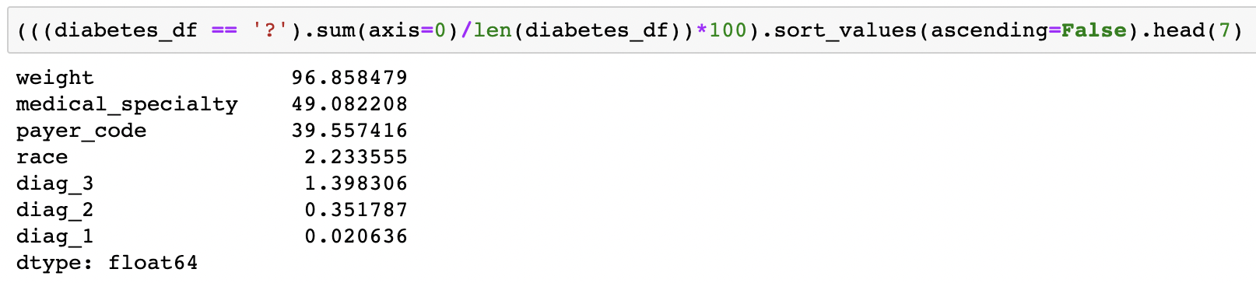


Nulls
Null values are not directly present in the data. It is subbed with '?' character.
High % of missing values and should be dropped:
Weight
Medical Specialty
Payer Code
Minor % of missing values and can be used:
Race
Diag_1
Diag_2
Diag_3
Notes:
Within this dataset, nulls were not directly present. Blanks were instead substituted with a question mark. Within python, I performed a quick calculation to find the top 7 features with the highest percentages of missing values. The features with the highest percentage of missing values were weight, medical specialty, and payer code and needed to be dropped. 96% of weight’s values were missing! Race and diagnoses 1,2, and 3 had a minor percentage of missing values and could be used. I included a formula I used in excel to calculate the percent of missing values for each variable to show an alternative to python. I simply counted the ? marks in each column and divided that by the number total entries of the column. You could even make a pivot table showing the percentage of nulls for each variable, but the python calculation was more time effective.

Slide 8
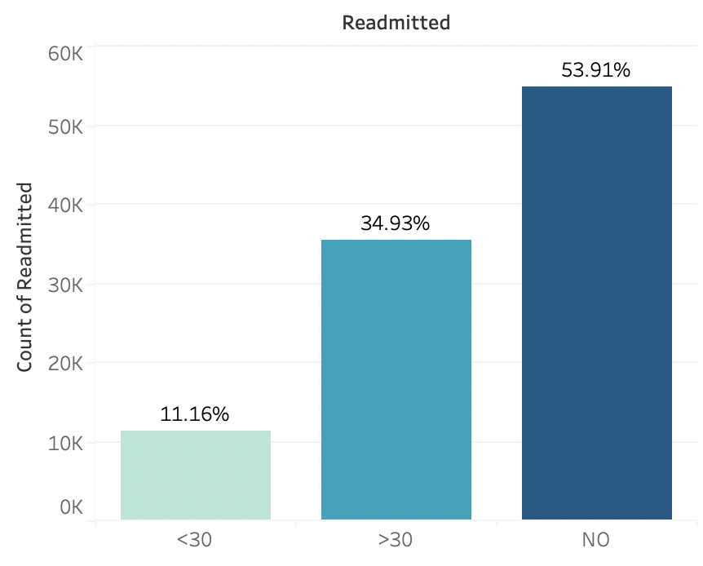
Exploring the Data
Readmitted
Readmission
About 11,357 patients were readmitted within 30 days
35,545 patients were readmitted after 30 days
Majority of patients were not readmitted
<30
>30
NO
Notes:
Now exploring our data, our most important column here is readmitted, which tells us if a patient was hospitalized within 30 days, greater than 30 days or not readmitted.
(11%) patients were readmitted within 30 days
(35%) patients were readmitted after 30 days
And a majority were not readmitted
For this project, we’ll be focusing in on encounters with a readmission within 30 days

Slide 9
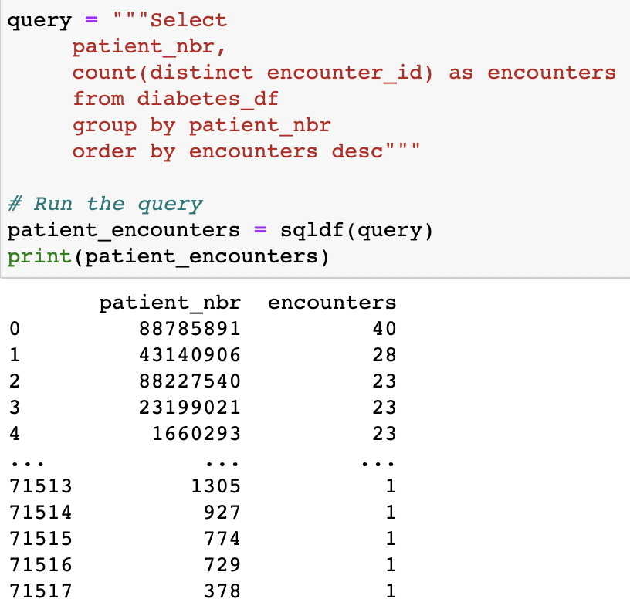
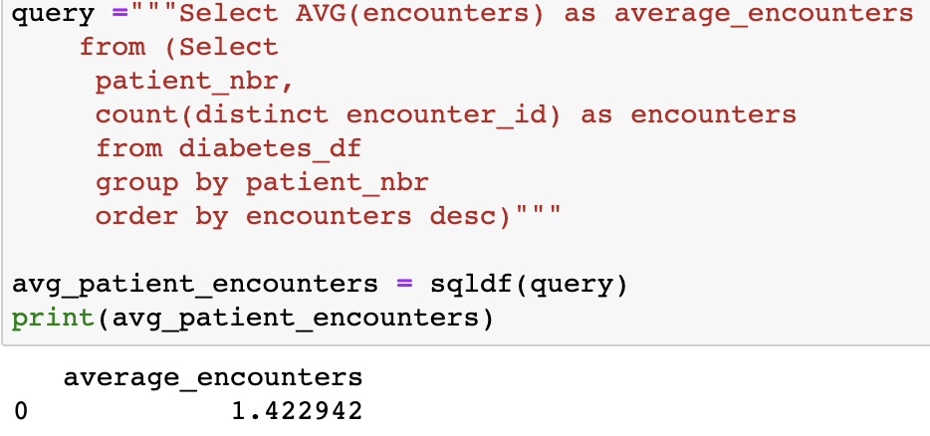
Exploring the Data
How many encounters by patient?
The average number of encounters by patient was approximately 1.42 encounters by patient
There were some outliers (ie: 1 patient having 40 encounters)
Notes:
Taking another broad look at our data, the average number of encounters by patient was approximately 1.42 encounters by patient. After querying the number of encounters per patient number in descending order, we can see that there are some outliers, with one patient having as high as 40 encounters.
The same python calculation can be done in excel by creating a pivot table with patient_nbr and count of encounter id’s, then taking the average of the count of encounter id’s row

Slide 10
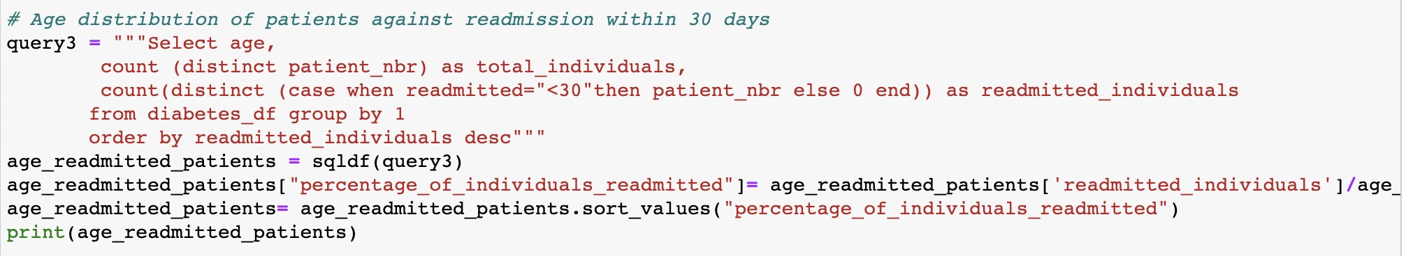
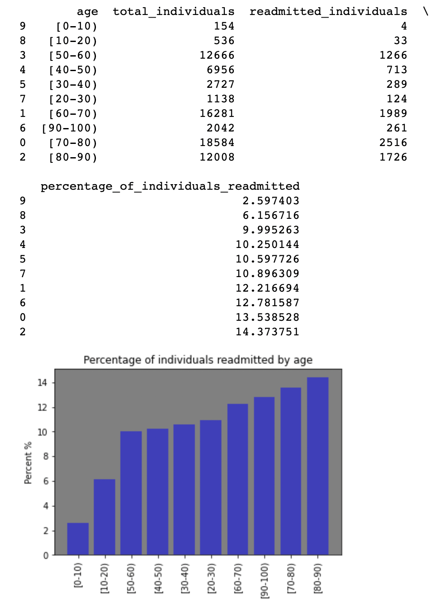
Exploring the Data
Age
Significant increase in percentage at 50
More likely to be readmitted within 30 days as age increases
Notes:
Part of my hypothesis was that patients with higher age are more likely to have readmission within 30 days. So I created an age distribution of patients against 30 day readmission. So for the total amount of individuals of each age bin, I took the percentage of readmitted individuals for each age bin. Here we can see a significant increase in percentage at 50 years old, and that the percentage of individuals readmitted within 30 days increases with age.

Slide 11
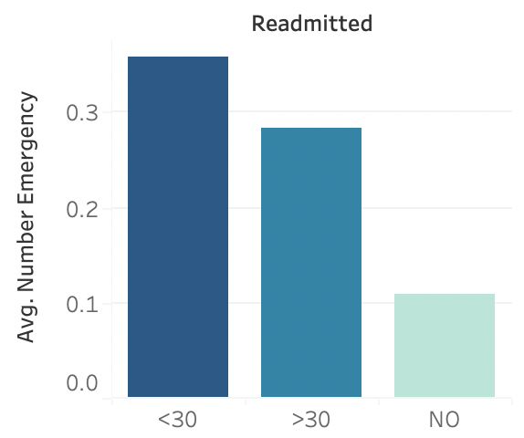
Exploring the Data
Mean Number of Emergency Visits
Patients readmitted within 30 days had a higher average of emergency visits
Notes:
Part of my hypothesis was that patients with a history of high emergency visits are more likely to have readmission within 30 days. Here we can see the pattern of patients readmitted within 30 days having a higher average of past emergency visits.
To further explore emergency visits, I continued to investigate on the next slide
Number of emergency visits of the patient in the year preceding the encounter

Slide 12
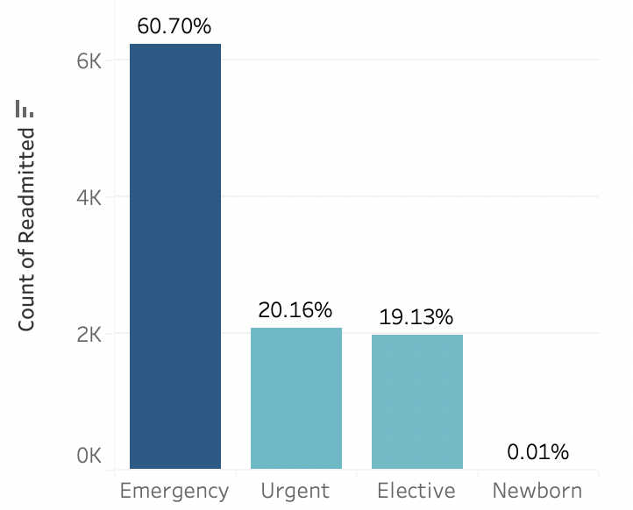
Which admission type is the most prevalent in readmission <30 days?
Admission Type
Emergency admissions account for 60% of readmission <30 days encounters
Notes:
Here I took a look at admissions types within 30 day readmission encounters. We see that Emergency admissions account for 60% of readmission <30 days encounters! Showing a trend of 30 day readmission with emergency visits .

Slide 13
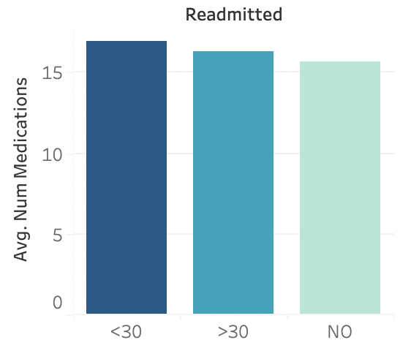
Exploring the Data
Mean Number of Medications
Readmissions have higher averages of medications prescribed

Slide 14
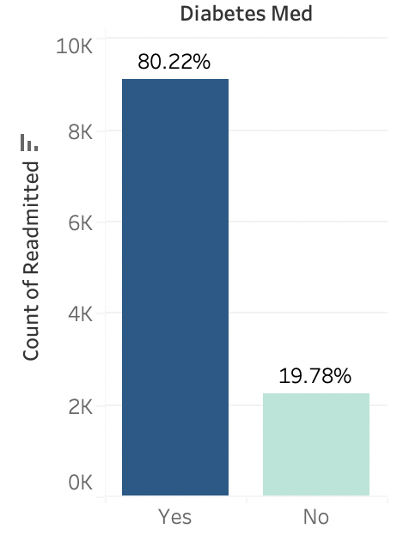
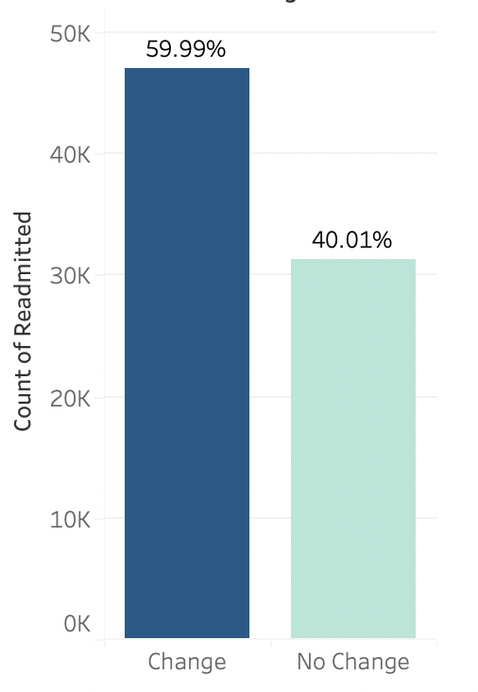
Effects of Medication
Prescribed Diabetes Medication
Change in Diabetes Medication
*Patients readmitted within 30 days were more likely to have been prescribed medication
Change in medication accounts for ~60% of readmission <30 days encounters
Notes:
For those who were given medication, was there a change in medication
Initial hypothesis that no medication translates to higher readmission rates was false

Slide 15
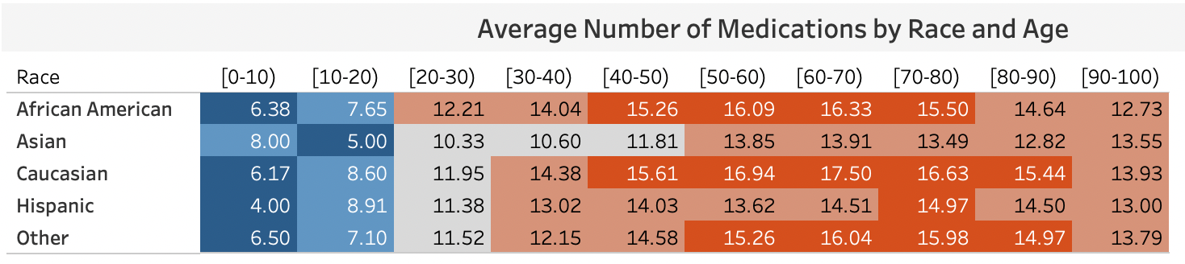
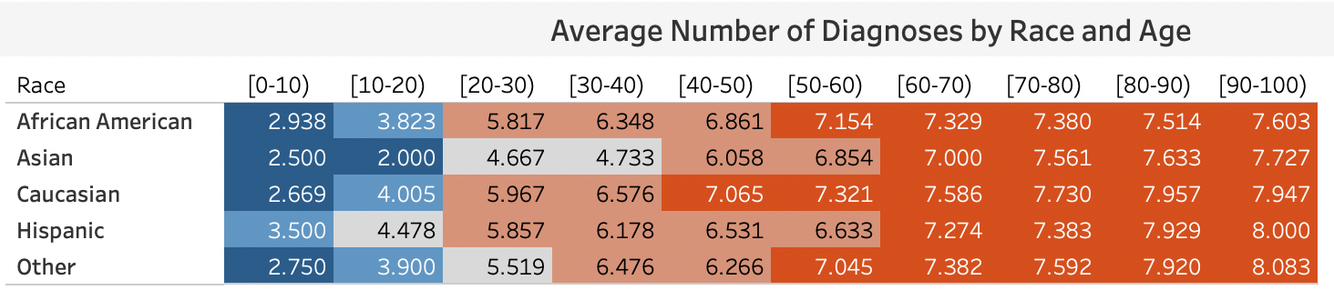
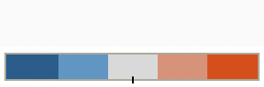
Exploring the Data

Slide 16
Conclusion
Readmission status within 30 days indicates that something went wrong or was missed in the patient’s first visit
Features we explored: age, number of emergency visits, prescribed medication, and change in medication
Major features correlating with higher readmission rates within 30 days…
Higher age (80-90 years)
Higher number of emergency visits
Admission type (emergency visits)
Taking medication
Change in medications
Notes:
What would you like to do with the data

Slide 17
Questions?
Notes:
Weaknesses, areas of improvement, variables that would be useful
Limitation: the binning of age limits its true effects, having a discrete or numeric age variable would be much more valuable
Additional variables such as income, family history, data relating to patient lifestyle habits or other medical conditions would provide valuable
Opportunity to build a machine learning classifier model to predict diabetes patients with high risk of readmission.
To correctly predict the readmission and avoid extra cost, hospitals should carefully examine the clinical data of patients and pay special attention to the above major features.

